Slide 1
Part 1:
Java as an Object-oriented Programming Language
08. Data Structures

Slide 2
Array basics

Slide 3
Data Structures
Sometimes, we have data that have some natural structure to them
  A few examples:
  Texts are sequences of characters
  Images are matrices of pixels
  Classes contain sets of students
Java provides a variety of classes and tools called data structures
  They help organize your data
  They make it convenient to access and update your data

Slide 4
Data Structures
Some common data structure classes in Java
  Array/Arrays (the data structure we will cover)
  ArrayList
  HashSet
  LinkedHashSet
  LinkedList
  TreeSet
  Vector
  HashMap

Slide 5

How would you solve this?
Consider the following program:
  How many days' temperatures? 7
  Day 1's high temp: 45
  Day 2's high temp: 44
  Day 3's high temp: 39
  Day 4's high temp: 48
  Day 5's high temp: 37
  Day 6's high temp: 46
  Day 7's high temp: 53
  Average temp = 44.57142857142857
  4 days were above average.

Slide 6
What makes the problem hard?
We need each input value twice
  … to compute the average via a cumulative sum
  … to count how many were above the average
What about putting the values into variables?
  How many variables would we declare?
Need a way to declare many variables at once.

Slide 7
Arrays
array: An object that stores many values of the same type.
  element: a value in an array
  index: an integer indicating the position of a value in an array
index
0
1
2
3
4
5
6
7
8
9
value
12
49
-2
26
5
17
-6
84
72
3
element 0
element 4
element 9

Slide 8
Array declaration
Declaring/initializing an array:
  <type>[] <name> = new <type>[<length>];
Example:
  int[] numbers = new int[10];
The length can be any integer expression:
  int x = 2 * 3 + 1;
  int[] data = new int[x % 5 + 2];
index
0
1
2
3
4
5
6
7
8
9
value
0
0
0
0
0
0
0
0
0
0

Slide 9
Array auto-initialization
When arrays are initially constructed, every element is automatically initialized to a "zero-equivalent" value.
  int: 0
  double: 0.0
  boolean: false
  object type: null (null means "no object")‏

Slide 10
Array auto-initialization: Example
An array of doubles
An array of booleans
index
0
1
2
3
4
value
0.0
0.0
0.0
0.0
0.0
index
0
1
2
3
value
false
false
false
false

Slide 11
Assigning array elements
Assigning a value to an array element:
  <array name>[<index>] = <value>;
Example:
  numbers[0] = 27;
  numbers[3] = -6;
index
0
1
2
3
4
5
6
7
8
9
value
27
0
0
-6
0
0
0
0
0
0

Slide 12
Accessing array elements
Using an array element's value in an expression:
  <array name>[<index>]
Example:
  System.out.println(numbers[0]);
  if (numbers[3] < 0) {
  System.out.println("Element 3 is negative.");
  }
index
0
1
2
3
4
5
6
7
8
9
value
27
0
0
-6
0
0
0
0
0
0

Slide 13
Don't go out of bounds!
Reading or writing any index outside the valid range will throw an ArrayIndexOutOfBoundsException.
Example:
  int[] data = new int[10];
  System.out.println(data[0]); // okay
  System.out.println(data[-1]); // exception!
  System.out.println(data[9]); // okay
  System.out.println(data[10]); // exception!
index
0
1
2
3
4
5
6
7
8
9
value
0
0
0
0
0
0
0
0
0
0

Slide 14
Arrays and for loops
Arrays are very commonly used with for loops to access each element
Example:
  for (int i = 0; i < 8; i++) {
  System.out.print(numbers[i] + " ");
  }
  System.out.println(); // end the line of output
  Output:
  0 4 11 0 44 0 0 2

Slide 15
Arrays and for loops
for (int i = 0; i < 8; i++) {
numbers[i] = 2 * i;
}
What’s in the array?
index
0
1
2
3
4
5
6
7
value
0
2
4
6
8
10
12
14

Slide 16
Arrays and for loops
for (int i = 0; i < 8; i++) {
numbers[i] = i * i;
}
What’s in the array?
index
0
1
2
3
4
5
6
7
value
0
1
4
9
16
25
36
49

Slide 17
The length field
An array's length field stores its number of elements.
General syntax:
  <array name>.length
NB: Because it's a field (i.e. not a method), it does not use parentheses like a String's .length()!

Slide 18
Example
for (int i = 0; i < numbers.length; i++) {
System.out.print(numbers[i] + " ");
}
Output:
  0 1 4 9 16 25 36 49
What expression refers to the last element of an array? The middle element?

Slide 19
How it all started…
Solve the following problem:
  How many days' temperatures? 7
  Day 1's high temp: 45
  Day 2's high temp: 44
  Day 3's high temp: 39
  Day 4's high temp: 48
  Day 5's high temp: 37
  Day 6's high temp: 46
  Day 7's high temp: 53
  Average temp = 44.57142857142857
  4 days were above average.

Slide 20
Solution
// This program reads several days' temperatures from the user
// and computes the average and how many days were above average.
import java.util.*;
public class Weather {
public static void main(String[] args) {
Scanner console = new Scanner(System.in);
System.out.print("How many days' temperatures? ");
int days = console.nextInt();
int[] temperatures = new int[days]; // array to store days' temperatures
int sum = 0;
for (int i = 0; i < days; i++) { // read/store each day's temperature
System.out.print("Day " + (i + 1) + "'s high temp: ");
temperatures[i] = console.nextInt();
sum += temperatures[i];
}
double average = (double) sum / days;
int count = 0; // see if each day is above average
for (int i = 0; i < days; i++) {
if (temperatures[i] > average) {
count++;
}
}
// report results
System.out.println("Average temp = " + average);
System.out.println(count + " days above average");
}
}

Slide 21
Why are arrays useful
Arrays store a large amount of data accessible from one variable.
Arrays let us access data in random order.
  Cassette tape vs. DVD
Arrays can represent sequential data.
  An array of quiz scores can store not just the scores, but also the order in which the quizzes were taken.

Slide 22
Array initialization statement
Quick array initialization, general syntax:
  <type>[] <name> = {<value>, <value>, ..., <value>};
Example:
  int[] numbers = { 12, 49, -2, 26, 5, 17, -6 };
Useful when you know in advance what the array's element values will be.
index
0
1
2
3
4
5
6
value
12
49
-2
26
5
17
-6

Slide 23
Example
int[] a = { 2, 5, 1, 6, 14, 7, 9 };
for (int i = 1; i < a.length; i++) {
a[i] += a[i - 1];
}
What’s in the array?
index
index
0
0
1
1
2
2
3
3
4
4
5
5
6
6
value
value
2
2
5
7
1
8
6
14
14
28
7
35
9
44

Slide 24
Printing arrays: Arrays.toString
Arrays.toString accepts an array as a parameter and returns the String representation, which you can then print.
Example:
  int[] a = { 2, 5, 1, 6, 14, 7, 9 };
  for (int i = 1; i < a.length; i++) {
  a[i] += a[i - 1];
  }
  System.out.println("a is " + Arrays.toString(a));
  Output:
  a is [2, 7, 8, 14, 28, 35, 44]

Slide 25
Shifting elements in an array

Slide 26
Array insertion
How would you insert a number into an array of sorted integers? Assume that the largest number gets bumped off the array.
index
0
1
2
3
4
value
1
6
18
37
64
index
0
1
2
3
4
value
1
3
6
18
37

Slide 27
Array insertion: Solution
public static void insertInOrder(int[] array, int num) {
int insertionIndex = findInsertionIndex(array, num);
if (insertionIndex < array.length) {
for (int i = array.length - 1; i >= insertionIndex + 1; i--) {
array[i] = array[i-1];
}
array[insertionIndex] = num;
}
}
public static int findInsertionIndex(int[] array, int num) {
for (int i = 0; i < array.length; i++) {
if (num < array[i]) {
return i;
}
}
return array.length;
}

Slide 28
Rotating elements left
index
0
1
2
3
4
value
3
8
9
7
5
index
0
1
2
3
4
value
8
9
7
5
3

Slide 29
Rotating elements left: Solution
public static void rotateLeft(int[] array) {
int first = array[0];
for (int i = 0; i < array.length - 1; i++) {
array[i] = array[i + 1];
}
array[array.length - 1] = first;
}
What assumptions does this code make?

Slide 30
Exercise: Random elements
Write a method named printRandomNumbers that accepts an array of integers as one parameter, and n, how many numbers to print, as a second parameter. The method will print out n random elements with repetition from the array.
Write a method named printRandomNumbers that accepts an array of integers as one parameter, and n, how many numbers to print, as a second parameter. The method will print out n random elements without repetition from the array.

Slide 31
Solution: Random elements
public static void printRandomNumbers(int[] numbers, int n) {
Random rand = new Random();
int numNumbers = numbers.length;
for (int i = 1; i <= n; i++) {
int index = rand.nextInt(numNumbers);
System.out.println(numbers[index]);
// shift elements to the left
for (int j = index; j < numNumbers - 1; j++) {
numbers[j] = numbers[j + 1];
}
numNumbers--;
}
}
What happens to the array after this method finishes?
  How could you preserve the contents of the array?

Slide 32
Enum
Use Enum to create a data type that has a set of possible discrete values
Example:
public enum Monster{ZOMBIE, VAMPIRE, DEMON, WEREWOLF};
Enum names are capitalized because an enum defines a type, not a variable
Values are in all-caps because they are constants; each instance of the enum has one of these constant values

Slide 33
Enum
Define a variable of an enum type:
Monster m = Monster.ZOMBIE;
Test whether a variable has a particular value:
  if(m == Monster.ZOMBIE) System.out.println(“Zombie approaching!”);
Use as method parameter:
myMethod(Monster m){}
Send as argument:
myMethod(Monster.ZOMBIE);

Slide 34
Multi-dimensional arrays

Slide 35
How can we store a table of values?
Let’s say there’s a class of 8 students,
with 10 quiz grades each:
How can we declare variables to store all this data?
7.5 | 4.5 | 9.5 | 2 | 7 | 8.5 | 1 | 8.5 | 7.5 | 6
… | … | … | … | … | … | … | … | … | …
… | … | … | … | … | … | … | … | … | …
… | … | … | … | … | … | … | … | … | …
… | … | … | … | … | … | … | … | … | …
… | … | … | … | … | … | … | … | … | …
… | … | … | … | … | … | … | … | … | …
4.5 | 2 | 9 | 9 | 5.5 | 4 | 7.5 | 6 | 5 | 9

Slide 36
Solution 1: An array per student
double [] student1 = new double[10];
...
double [] student8 = new double[10];
student1:
...
student8:
Tedious!
7.5 | 4.5 | 9.5 | 2 | 7 | 8.5 | 1 | 8.5 | 7.5 | 6
4.5 | 2 | 9 | 9 | 5.5 | 4 | 7.5 | 6 | 5 | 9

Slide 37
Solution 2: An array per quiz
double [] quiz1 = new double[8];
...
double [] quiz10 = new double[8];
quiz1:
...
quiz10:
Tedious!
7.5 | … | … | … | … | … | … | 4.5
6 | … | … | … | … | … | … | 9

Slide 38
Solution 3: 2-dimensional arrays!
double [][] quizScores = new double[8][10];
quizScores:
quizScores[0][6]
7.5 | 4.5 | 9.5 | 2 | 7 | 8.5 | 1 | 8.5 | 7.5 | 6
… | … | … | … | … | … | … | … | … | …
… | … | … | … | … | … | … | … | … | …
… | … | … | … | … | … | … | … | … | …
… | … | … | … | … | … | … | … | … | …
… | … | … | … | … | … | … | … | … | …
… | … | … | … | … | … | … | … | … | …
4.5 | 2 | 9 | 9 | 5.5 | 4 | 7.5 | 6 | 5 | 9
quizScores[7][9]

Slide 39
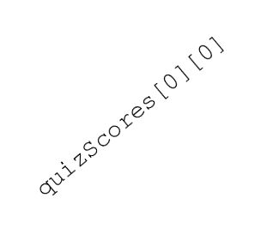
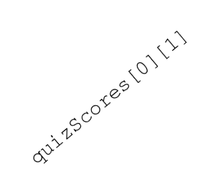
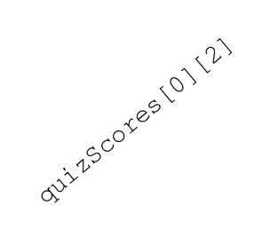
2-D Arrays in memory
A 2-D array is really an array of arrays!
double [][] quizScores = new double[4][3];
quizScores
quizScores[0]
quizScores[1]
quizScores[2]
quizScores[3]

Slide 40
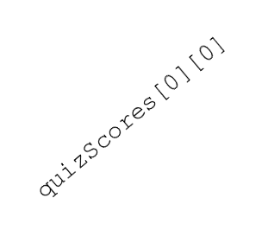
Ragged 2-D arrays
double [][] quizScores = new double[4][];
quizScores[0] = new double[3];
quizScores[2] = new double[5];
quizScores
quizScores[0]
quizScores[1]
quizScores[2]
quizScores[3]

Slide 41
Exercises
Compute the trace, or sum of the elements on the diagonal of a matrix.
Swap each element in a square 2-D array with elements on the opposite side of the main diagonal.

Slide 42
Text processing

Slide 43
Text processing
text processing: Examining, editing, formatting text.
  Text processing often involves for loops that examine the characters of a string one by one.
Two data types involved
char | String
Represents individual characters | Represents sequences of characters
Primitive type | Object type (i.e., not primitive)
Written with single quotes | Written with double quotes
e.g.: ‘T’ ‘t’ ‘3’ ‘%’ ‘\n’ | e.g.: “We the people” “1. Twas brillig, and the slithy toves\n” “” “T”

Slide 44
Characters
char: A primitive type representing single characters.
Individual characters inside a String are stored as char values.
Literal char values are surrounded with apostrophe
(single-quote) marks, such as 'a' or '4' or '\n' or '\''
Like any other type, you can create variables, parameters, and returns of type char.
  char letter = 'S';
  System.out.println(letter); // prints S

Slide 45
Strings
String: an object type for representing sequences of characters
  Sequence can be of length 0, 1, or longer
  Each element of the sequence is a char
  We write strings surrounded in double-quotes
  We can declare, initialize, assign, and use String variables in expressions just like other data types
  String s = “Hello, world\n”; // declare, init
  System.out.println(s); // use value
  s = s + “I am your master\n”; // concatenate
  // and assign

Slide 46
String Methods
Unlike primitive types, object types can have methods.
Here is a list of methods for strings:
Method name
Description
charAt(index)‏
returns the character at the given index
indexOf(str)‏
returns the index where the start of the given string appears in this string (-1 if not found)‏
length()‏
returns the number of characters in this string
substring(index1,index2)‏
returns the characters in this string from index1 up to, but not including, index2
toLowerCase()‏
returns a new string with all lowercase letters
toUpperCase()‏
returns a new string with all uppercase letters

Slide 47
The charAt method
The characters of a string can be accessed using the String object's charAt method.
  String indices start at 0.
String word = “cola”;
char firstLetter = word.charAt(0);
if (firstLetter == 'c') {
System.out.println("C is for cookie!");
}
Starts at 0!
charAt(i): | ‘c’ | ‘o’ | ‘l’ | ‘a’
Index i: | 0 | 1 | 2 | 3

Slide 48
Calling string methods
Let s be a variable of type String
General syntax for calling a String method:
s.<method>(<args>)
Some examples:
String s = “Cola”;
int len = s.length(); // len == 4
char firstLetter = s.charAt(0); // ‘C’
int index = s.indexOf(“ol”); // index == 1
String sub = s.substring(1,3); // “ol”
String up = s.toUpperCase(); // “COLA”
String down = s.toLowerCase(); // “cola”

Slide 49
Fun with char!
char values can be concatenated with strings.
  char initial = 'P';
  System.out.println(initial + ". Diddy");
You can compare char values with relational operators.
  'a' < 'b' and 'Q' != 'q'
  Caution: You should NOT use these operators on a String!
Example:
    // print the alphabet
    for (char c = 'a'; c <= 'z'; c++) {
    System.out.print(c);
    }

Slide 50
char vs. String
'h' is a char
  char c = 'h';
  char values are primitive; you cannot call methods on them
  can't say c.length() or c.toUpperCase()‏
"h" is a String
  String s = "h";
  Strings are objects; they contain methods that can be called
  can say s.length() 1
  can say s.toUpperCase() "H"
  can say s.charAt(0) 'h'

Slide 51
Numbers vs Strings
345 is an int
  int i = 345;
  int values are primitive; you cannot call methods on them
  CAN perform arithmetic: i = i * 2; // i==690
  CANNOT say i.length() or i.charAt(0)‏
“345" is a String
  String s = “345";
  Strings are objects; they contain methods that can be called
  can say s.length() // returns 3
  can say s.charAt(1) // returns ‘4’
  CANNOT perform arithmetic: s = s * 2; // ERROR!

Slide 52
Comparing strings
Objects (such as String) should be compared for equality by calling a method named equals.
Example:
  Scanner console = new Scanner(System.in);
  System.out.print("What is your name? ");
  String name = console.next();
  if (name.equals("Barney")) {
  System.out.println("I love you, you love me,");
  System.out.println("We're a happy family!");
  }

Slide 53
Comparing strings
There are more methods of a String object that can be used in <test> conditions.
Method
Description
equals(str)‏
whether this string contains exactly the same characters as the other string
equalsIgnoreCase(str)‏
whether this string contains the same characters as the other, ignoring upper- vs. lowercase differences
startsWith(str)‏
whether this string’s beginning matches the argument
endsWith(str)‏
whether this string’s end matches the argument

Slide 54
Comparing strings: Examples
Hypothetical examples, assuming the existence of various String variables:
  if (title.endsWith("M.D.")) {
  System.out.println("What's your number?");
  }
  if (fullName.startsWith("Giorgio")) {
  System.out.println("When are you retiring?");
  }
  if (lastName.equalsIgnoreCase("lumBerg")) {
  System.out.println("I need your TPS reports!");
  }
  if (name.toLowerCase().indexOf("sr.") >= 0) {
  System.out.println("You must be old!");
  }

Slide 55
Data type conversion
Sometimes, we want to change between types.
For example, 2640 feet = x in miles?
int x = 2640;
int y = 5280;
return x / y; // integer arithmetic
This returns 0 if 3000 and 5280 are both ints.

Slide 56
Data type conversion
Sometimes, we want to change between types.
For example, 3000 feet = x in miles?
int x = 2640;
int y = 5280;
double z = (double) x;
return z / y; // double arithmetic

Slide 57
Typecasting
An expression like this:
(<type>) <expression>
is called a typecast. It converts the expression into an equivalent expression of type <type>.
Examples:
(double) 2640 == 2640.0
(int) 32.7 == 32
(int) ‘A’ == ??
(char) 97 == ??
(String) ‘A’ == ??
(String) 27 == ??

Slide 58
Typecasting
An expression like this:
(<type>) <expression>
is called a typecast. It converts the expression into an equivalent expression of type <type>.
Examples:
(double) 2640 == 2640.0
(int) 32.7 == 32
(int) ‘A’ == 65
(char) 97 == ‘a’
(String) ‘A’ == TypeCastException
(String) 27 == TypeCastException

Slide 59
What about String typecasts?
The (String) typecasts don’t work with primitive types, like char, int, and double.
However, there are easy ways to convert to and from strings:
Converting to strings:
int x to String: x + “” or “” + x
double x to String: x + “” or “” + x
char, boolean, or float x to String: same thing

Slide 60
What about String typecasts?
The (String) typecasts don’t work with primitive types, like char, int, and double.
However, there are easy ways to convert to and from strings:
Converting from strings:
String s to int: Integer.parseInt(x)
String s to double: Double.parseDouble(x) …
String s to char: Character.parseChar(x)

Slide 61
Reading in Strings
Remember the Scanner method called nextInt()?
You can also use Scanners to read in Strings with the next() and hasNext() methods.
Example:
Please enter your name: Alexander Pieter Yates
Name 1 has 9 letters
Name 2 has 6 letters
Name 3 has 5 letters

Slide 62
Solution
import java.util.Scanner;
public class NameLength {
public static void main(String [] args) {
Scanner scan = new Scanner(System.in);
System.out.print(“Please enter your name”);
int i=1;
while(scan.hasNext()) {
String s = scan.next();
int length = s.length();
System.out.println(“Name “ + i + “ has “ + length + “ letters”);
i++;
}
}
}

Slide 63
Scanner class (so far)
return | method | Description
int | nextInt() | Reads the next token, converts it to an int (if possible), and returns the int value.
double | nextDouble() | Reads the next token, converts it to a double (if possible), and returns the double value.
String | next() | Reads the next token, and returns it.
boolean | hasNext() | Returns true if there are more tokens.

Slide 64
StringBuilder
The StringBuilder class is a supplement to the String class.
StringBuilder is more flexible than String. You can add, insert, or append new contents into a string buffer, whereas the value of a String object is fixed once the string is created.
You will often have to parse the StringBuilder to a String when you are done constructing it.

Slide 65
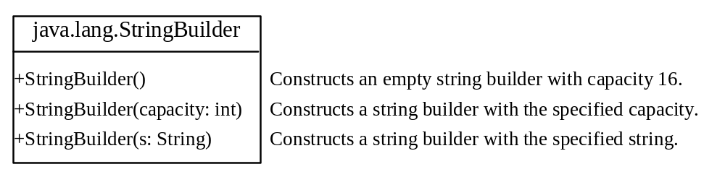
StringBuilder Constructors

Slide 66

Modifying Strings in the Builder

Slide 67

The toString, capacity, length, setLength, and charAt Methods

Slide 68
Examples
stringBuilder.append("Java");
stringBuilder.insert(11, "HTML and ");
stringBuilder.delete(8, 11) changes the builder to Welcome Java.
stringBuilder.deleteCharAt(8) changes the builder to Welcome o Java.
stringBuilder.reverse() changes the builder to avaJ ot emocleW.
stringBuilder.replace(11, 15, "HTML")
changes the builder to Welcome to HTML.
stringBuilder.setCharAt(0, 'w') sets the builder to welcome to Java.

Slide 69
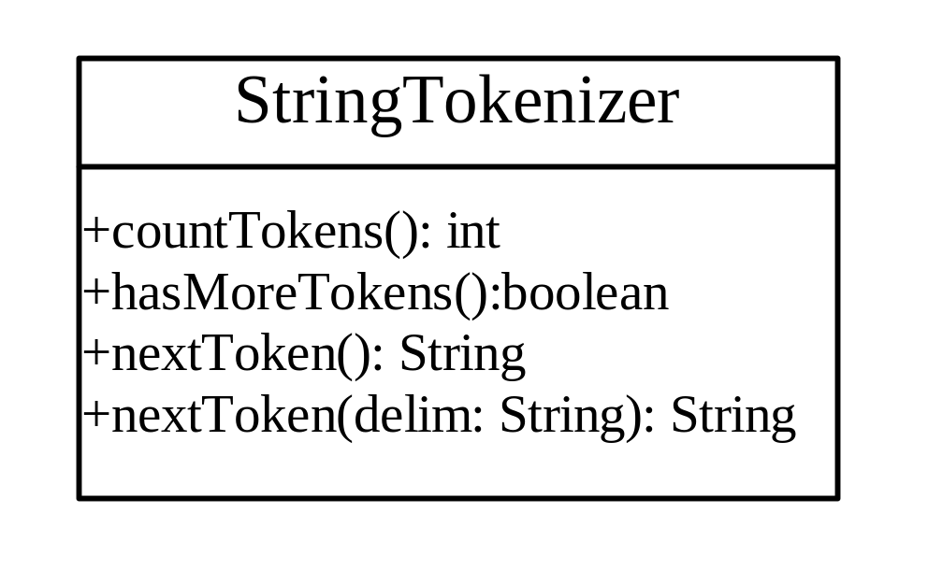
StringTokenizer
boolean hasMoreTokens()
String nextToken()
String nextToken(String delim)

